Slide 1

UBER EATS
Members: Guidance By:
22 Utkarsh Khandare DR. Arvind Jagtap
24 Rohit Dhotre
25 Vaibhav Barawkar
31 Yashraj Devrat
38 Shreyas Kulkarni

Slide 2
CONTENTS:
Objectives
Problem Statement
Introduction
Need of Project
Pestel Analysis
Empathy Map
Customer Journey Map
WH Questions
Conclusion

Slide 3

OBJECTIVES
ObjectivesUber Eats has both short term and long-term goals for our future marketing strategies, wehope to achieve our short-term goals within the next 12 months.
Our overall objective is topredominately increase both or customer and supplier satisfaction and over time we expectthis to change the public image and reputation of Uber Eats.
.Supplier satisfaction is our first priority. If the restaurant is invested they will be morepositive towards the drivers and therefore customers will be happier with how localbusinesses are being treated.
Restaurant managersmust ensure their staff are providing high quality food to be delivered and therefore Uberdrivers need to deliver the food with care.

Slide 4
PROBLEM STATEMENT
To have a super app where users can order almost anything, from a car ride to a meal to groceries

Slide 5
INTRODUCTION:
Uber Eats is our food delivery platform that makes getting great food from your favorite local restaurants as easy as requesting a ride.
The Uber Eats app connects you with a broad range of local restaurants and food, so you can order from the full menus of your local favorites whenever you want.

Slide 6
NEED OF PROJECT :
Customers Prefer Ordering from Restaurant Websites & Apps Than Through Food Portals.
Using a Responsive Online Ordering System is Key to Unlocking Higher Sales.
Online Orders are Higher in Value than Phone Orders. ... It's Fast and Easy.

Slide 7
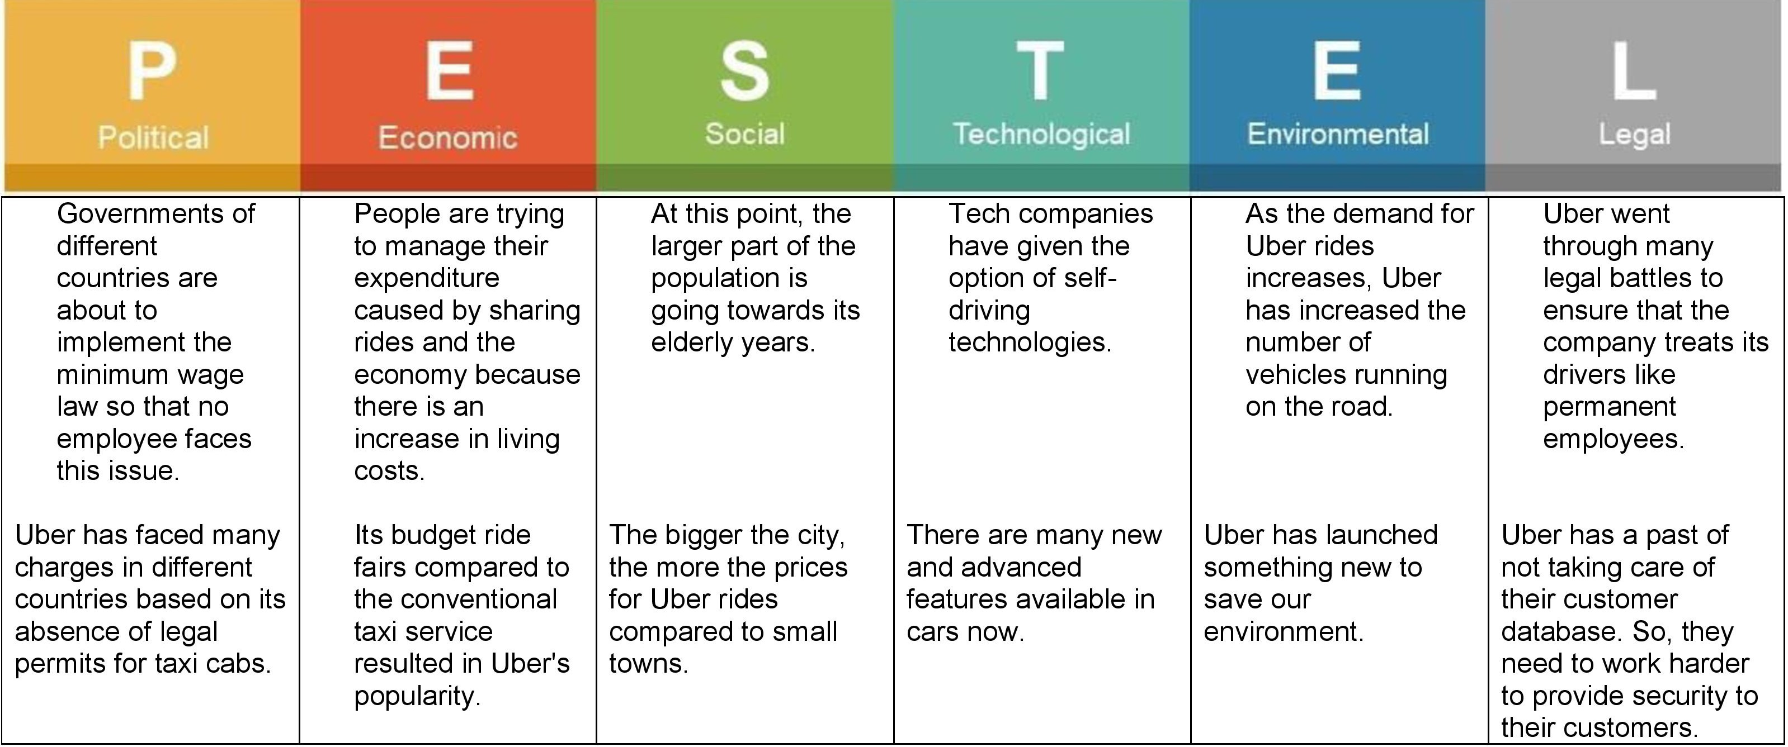
PESTEL ANALYSIS

Slide 8
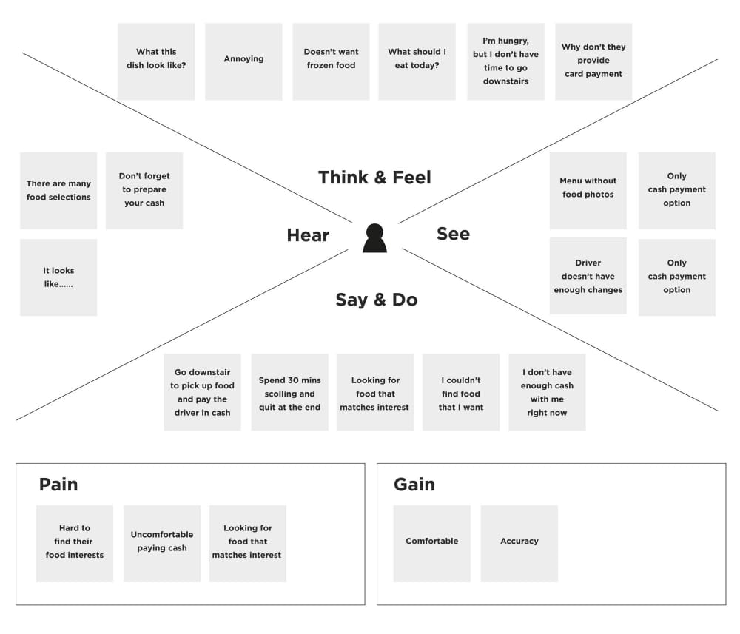
EMPATHY MAP:

Slide 9
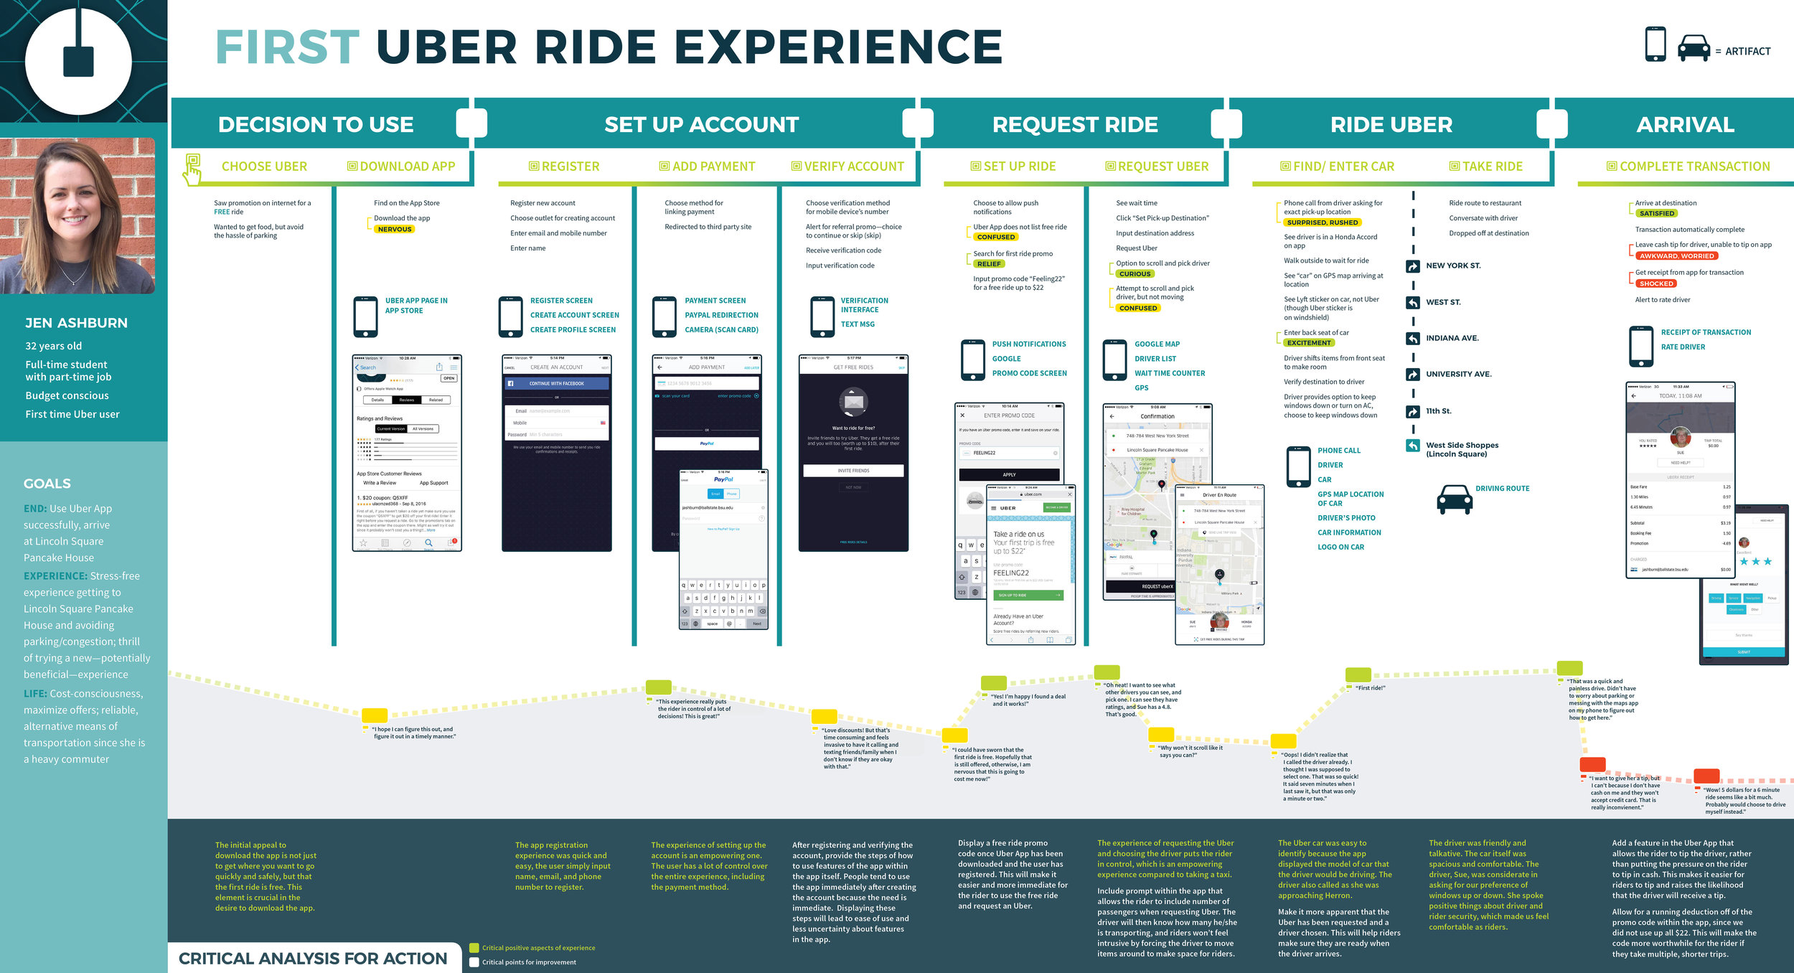
CUSTOMER JOURNEY MAP

Slide 10

5 WH QUESTIONS:
Should Uber Eats be a different app from Uber Rides?
What product that you led are you most proud of and why?
How would you reduce cancellation on Uber?
How would you describe and assess how the Uber Marketplace (the matching platform) is doing, for UberX?

Slide 11
CONCLUSION
The mission of Uber Eats is to “make eating well effortless at anytime, for anyone.”
Taking advantage of machine learning, UberEats enables taste preferences by suggesting cuisines according to past histories and existing contextual information. Therefore, users get customized choices of food from different restaurants at the push of a button.

Slide 12
THANK YOU

